Slide 1
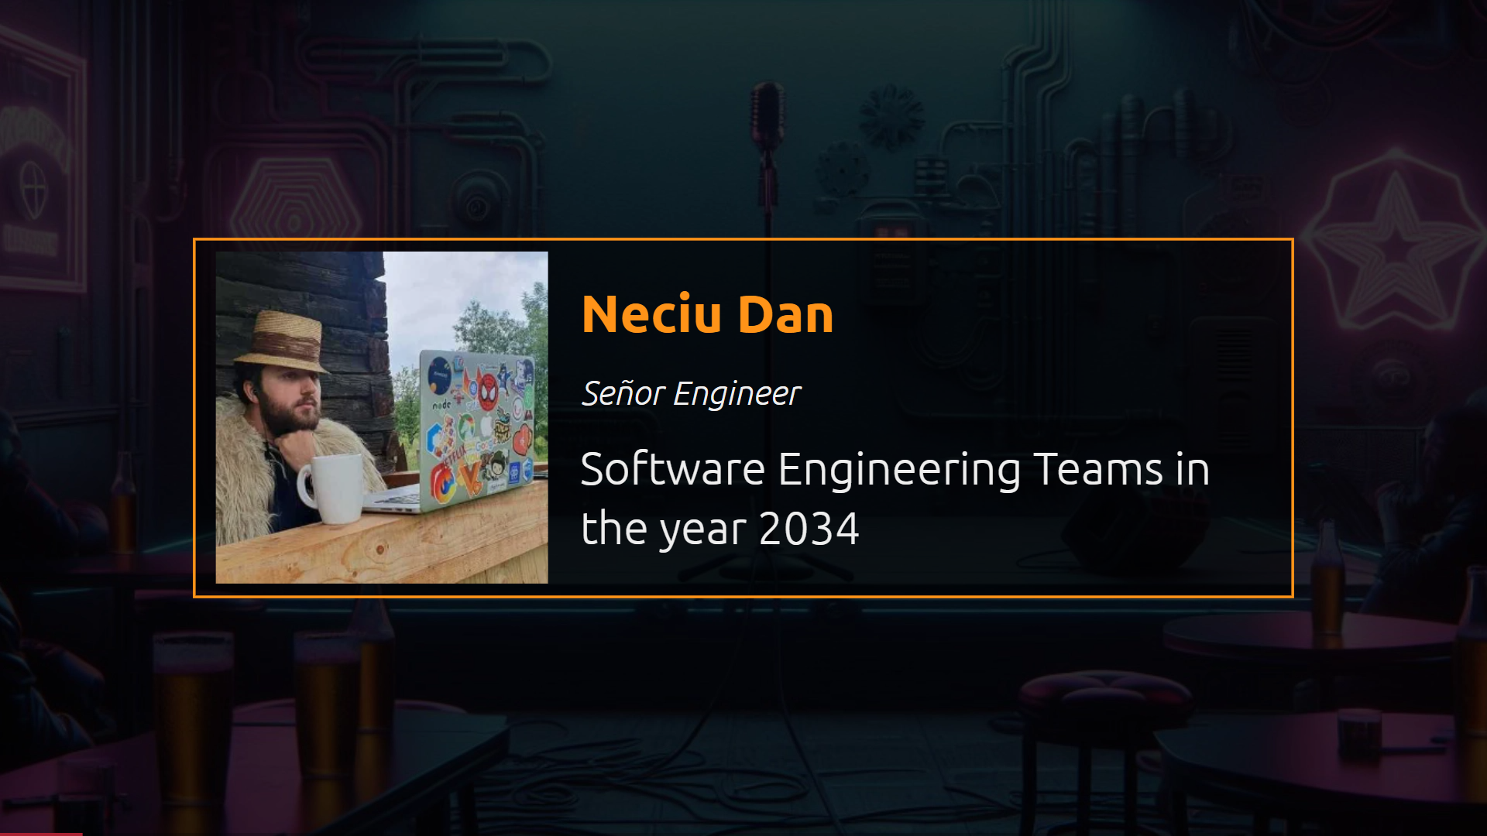

Slide 2
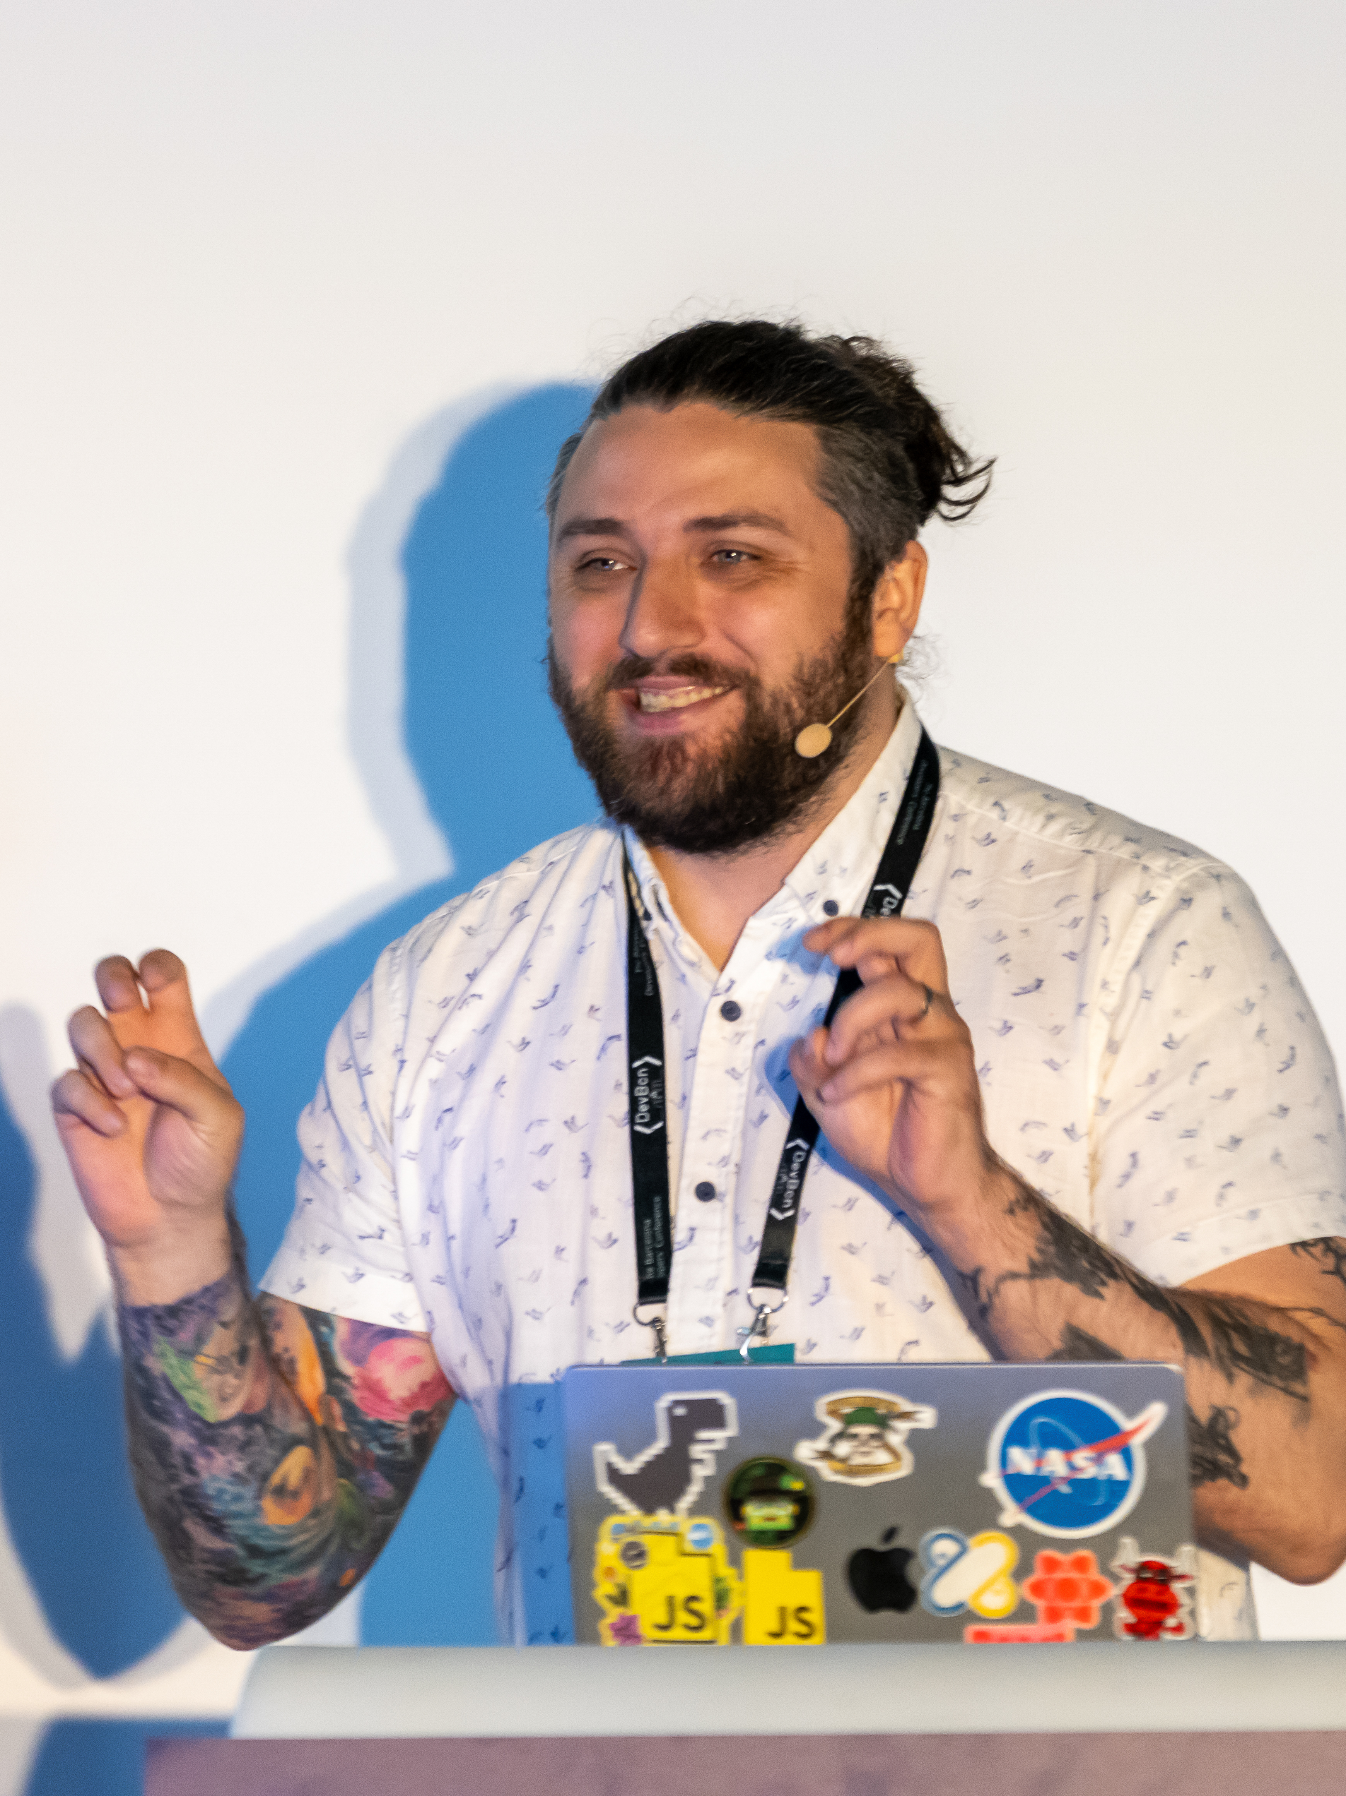
Software Engineering in 2034
The future is now
old man!
@neciudan
Notes:
The year is 2035, and the AI revolution is over! And everyone has lost!

Slide 3
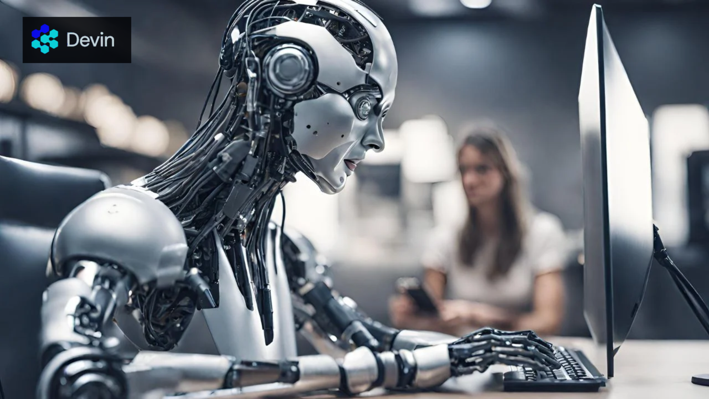
@neciudan
Notes:
Software Engineers have been replaced by AI, everybody saw that coming.

Slide 4
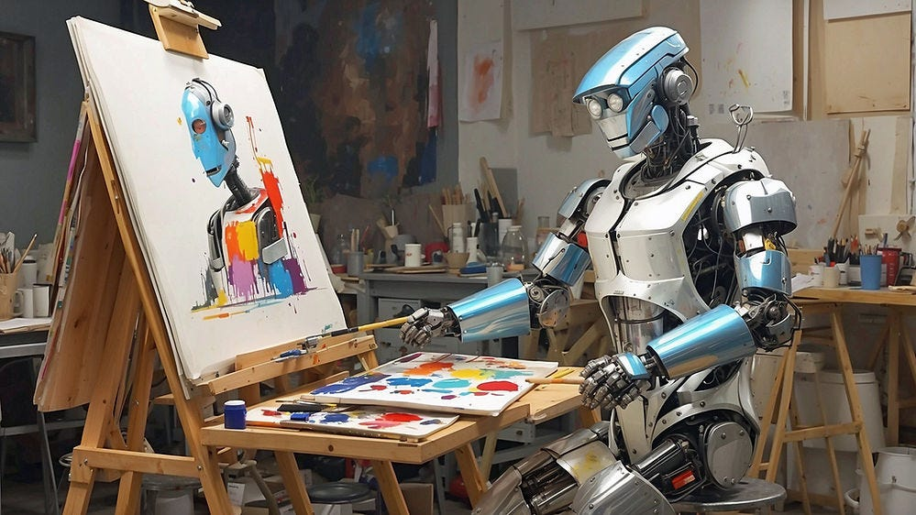
@neciudan
Notes:
Product Designers have been replaced by AI. Its just pixels on a board.

Slide 5
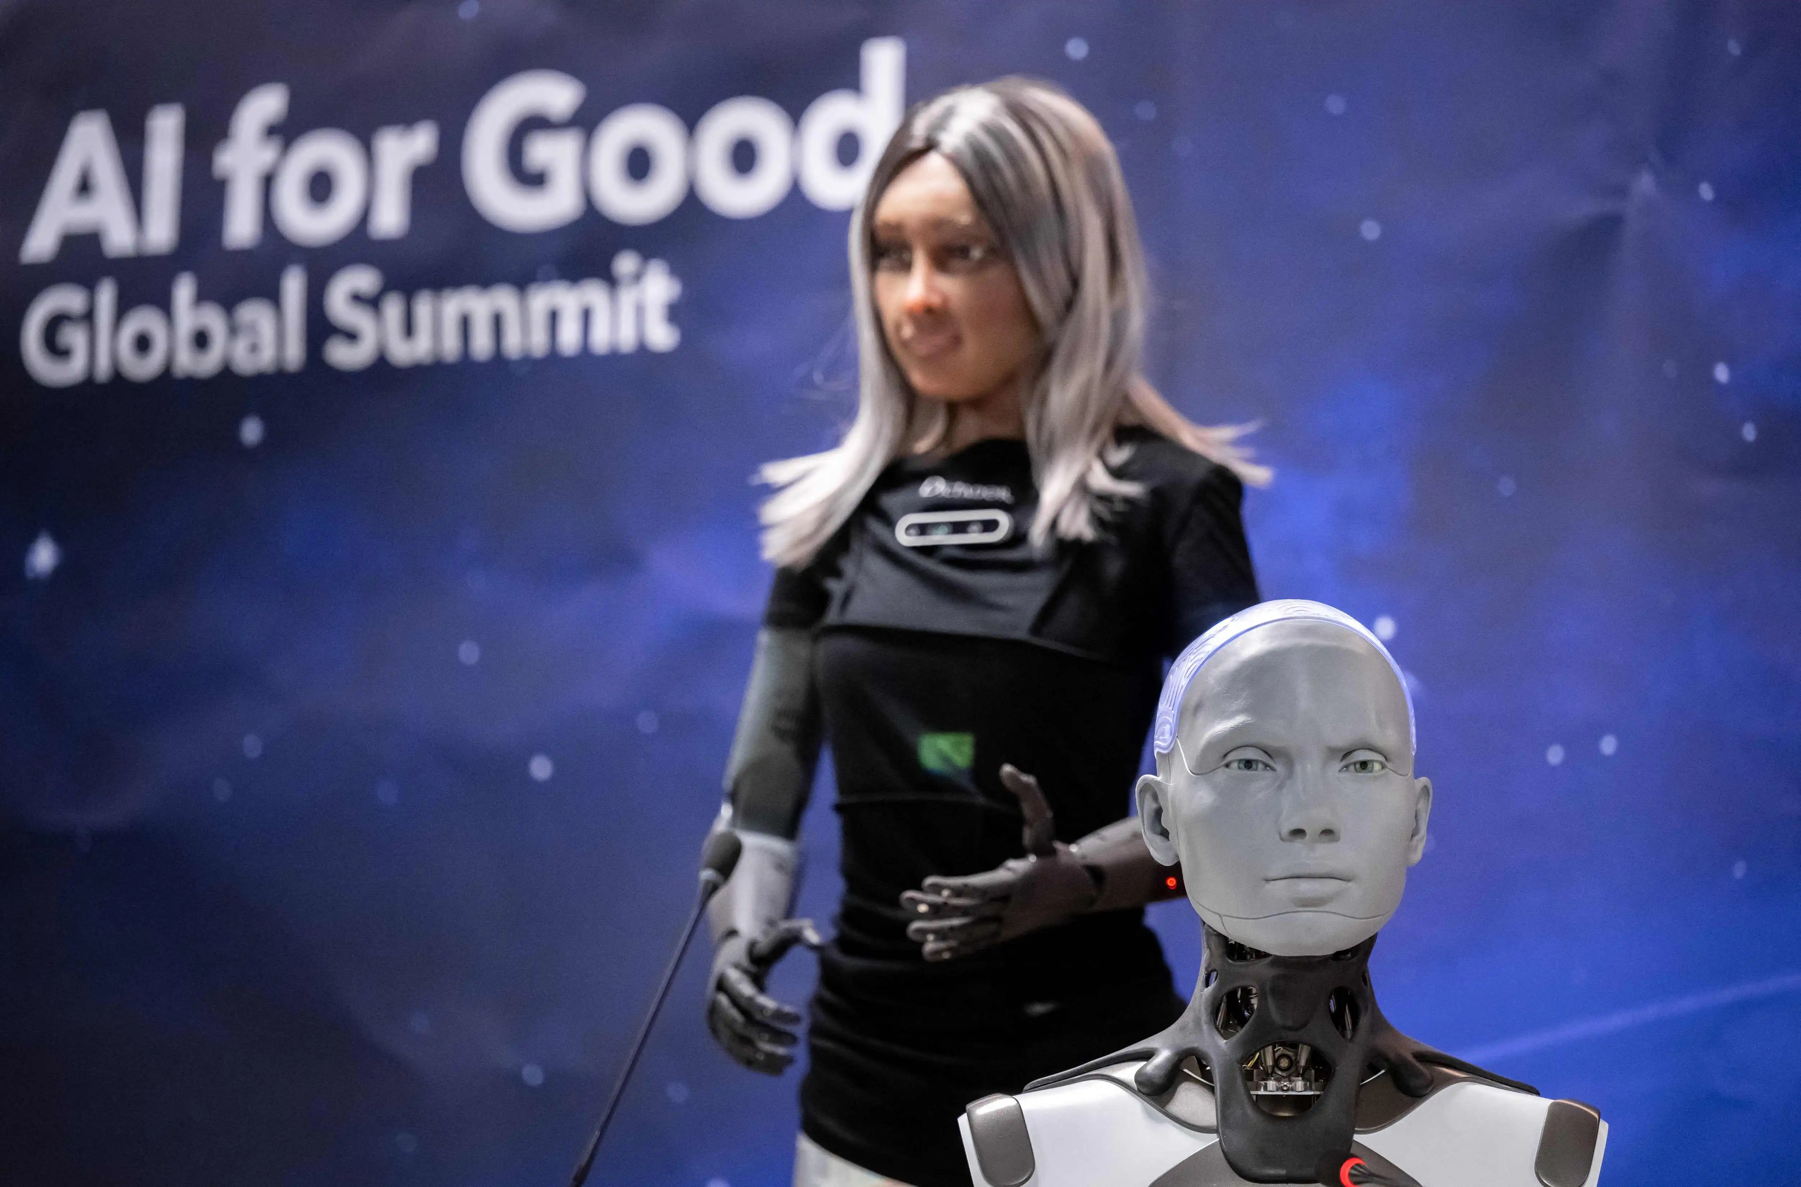
@neciudan
Notes:
C-level executives have also been replaced by AI. That way those nice bonuses can go directly to the board members.

Slide 6
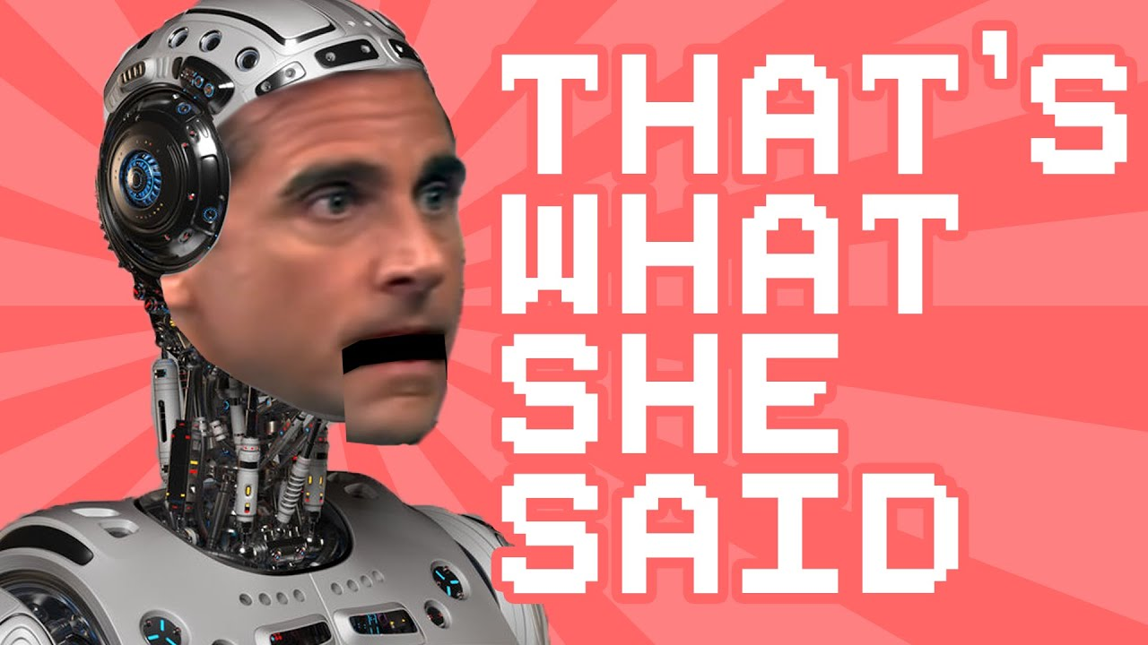
@neciudan
Notes:
Even Regional Office Managers have been replaced by AI to keep things funny in the office The only thing AI could not manage to learn and replace?

Slide 7
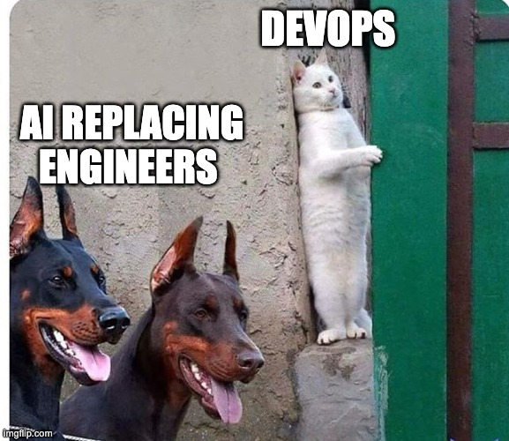
Notes:
Bob! The DevOps Engineer!
All the knowledge on the internet could not make an AI start a Kubernetes cluster correctly.
So, how does an engineering team look? In 2035?

Slide 8
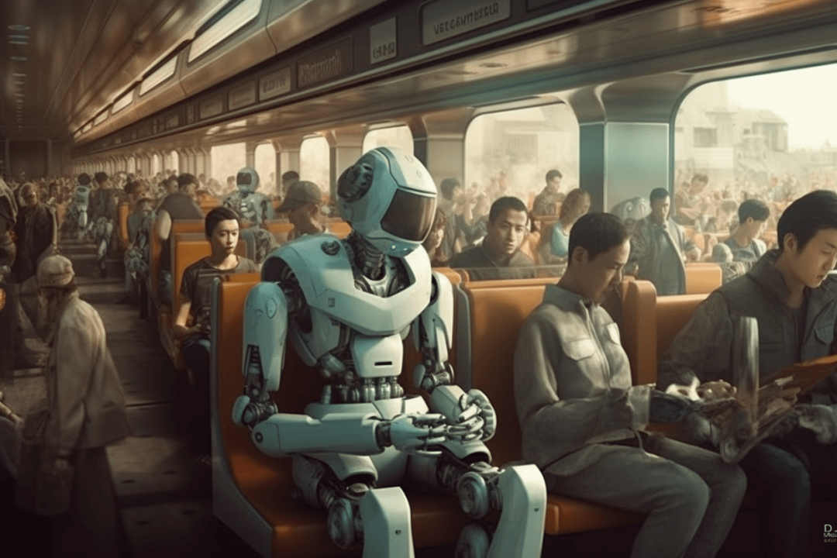
Notes:
Well, the C-level AI, trained on data from 2024, saw that they had to mandate return-to-office as soon as possible for all employees. Never mind that most of the employees were living in the cloud. We need to bring everyone back to the office! ASAP! So they can enjoy our one-fruit per-person policy.

Slide 9
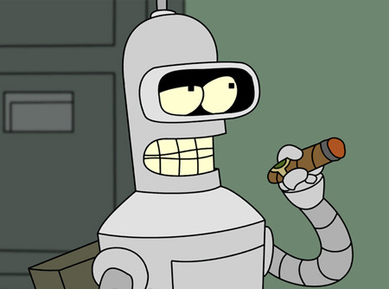
Notes:
We're building dedicated machines and robot exoskeletons for AI so they can walk and commute to the office every day, this for sure will increase the company's productivity.
We’re gonna make them smoke and drink and play blackjack too.

Slide 10
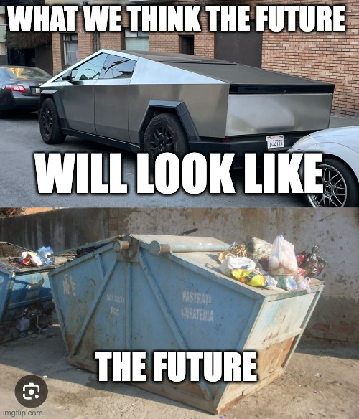
Notes:
This makes commuting a hassle for Bob the Devops Engineer. Because everyone is too busy using cybertrucks to come to the office while Bob has to suffer the 30mile commute with his bike.

Slide 11
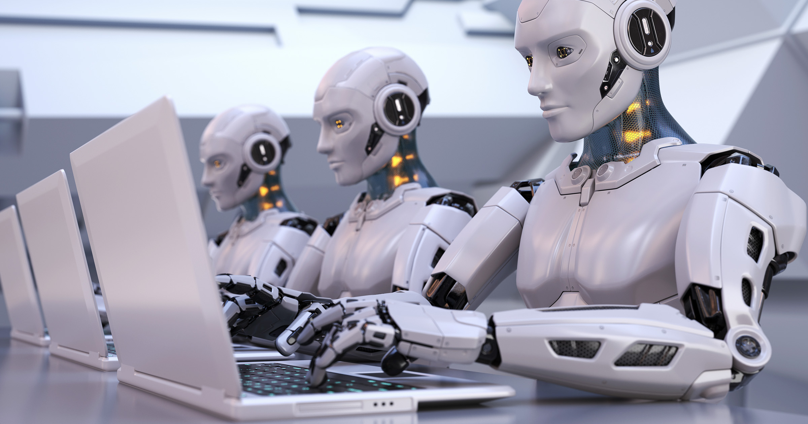
Notes:
Like all great companies, our C-level AIs decided to implement the Spotify Model for organizing our teams
So each Product Team has:
an AI Project Managers
An AI Engineering Manager
3 backend AI developers
2 AI Frontend developers
1 AI Product Designer
1 AI Data analyst
And of course Bob

Slide 12
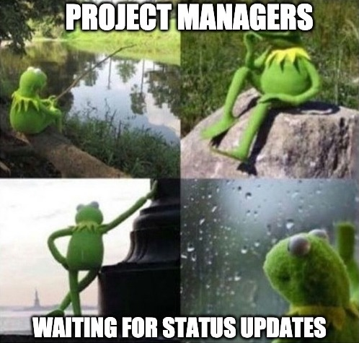
Notes:
The AI Project Manager inside the team runs GPT 0.5. The lowest GPT model in existance.
They decided it's not worth the hassle to give it more computing power as the only things it says are:
“Is the project ready?” or “Do you have a status update for me?” Or “When do you think you will finish with that task”

Slide 13
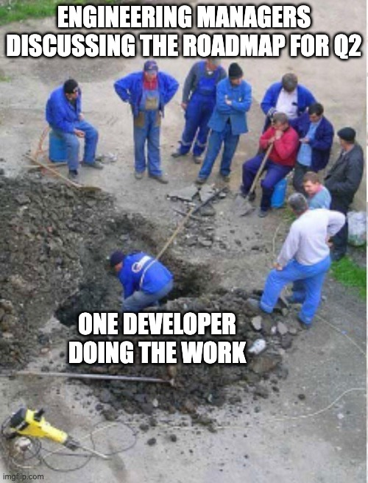
Notes:
Another key member of the team is the AI Engineering Manager, who continuously fights with other AI Engineering Managers in the company and Senior AI leadership for more resources for his team. As the AI quickly learned in his short time being alive, that being an effective engineering manager, you need other “people” or AI to manage so it made it its full time job to try to get more and more AIs to manage.
Even though His last 1-to-1 with Bob was in 2031.

Slide 14
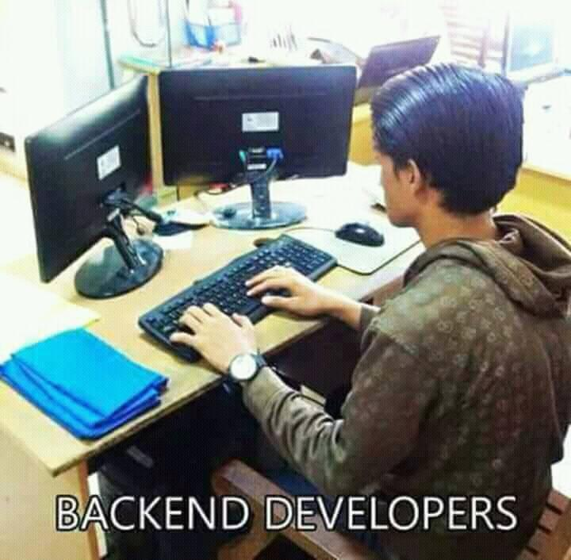
Notes:
Also inside the team are 3 AI Backend developers and as usual, they haven't written a single line of backend code during two weeks. When asked why, on a daily, they all point their metallic fingers in unison and say, "It's the frontend’s fault—the CSS broke our algorithms!”

Slide 15
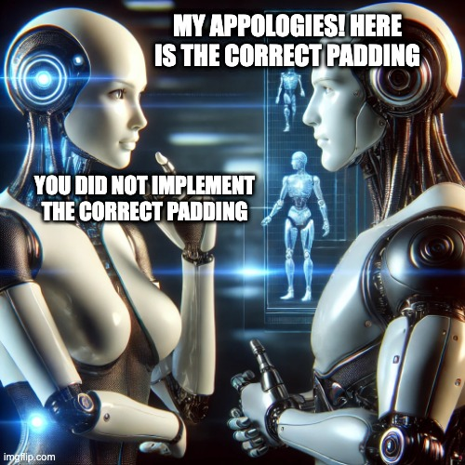
Notes:
In the meantime the AI Designer and the AI Frontend Engineer are arguing in every channel. Apparently the Frontend AI did not implement the correct padding for the boxes.
The AI designer says you did not implement the correct padding of 24.3 pixels, the frontend Appologies and implements it as 24. Here you go it says.
The AI designer says thank you, verifies and again sees that its not correctly implemented as 24.3 pixels.
And repramands the AI Frontend again. This time the AI frontend says the design is not correct

Slide 16
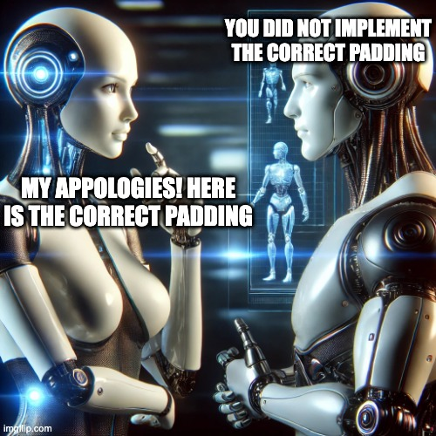
Notes:
So the AI Designer now appologies and changes the padding from 24.3 to 25.3, giving to the AI frontend to implement. Which in turn implements it as 25 pixels, and then the AI designer says its incorrect.

Slide 17
Notes:
This goes on for the whole sprint.
Again and again. Moving from 24 pixels to 25 pixels, If only the Project Manager did not use gpt 0.5 then surely he could unblock them.

Slide 18
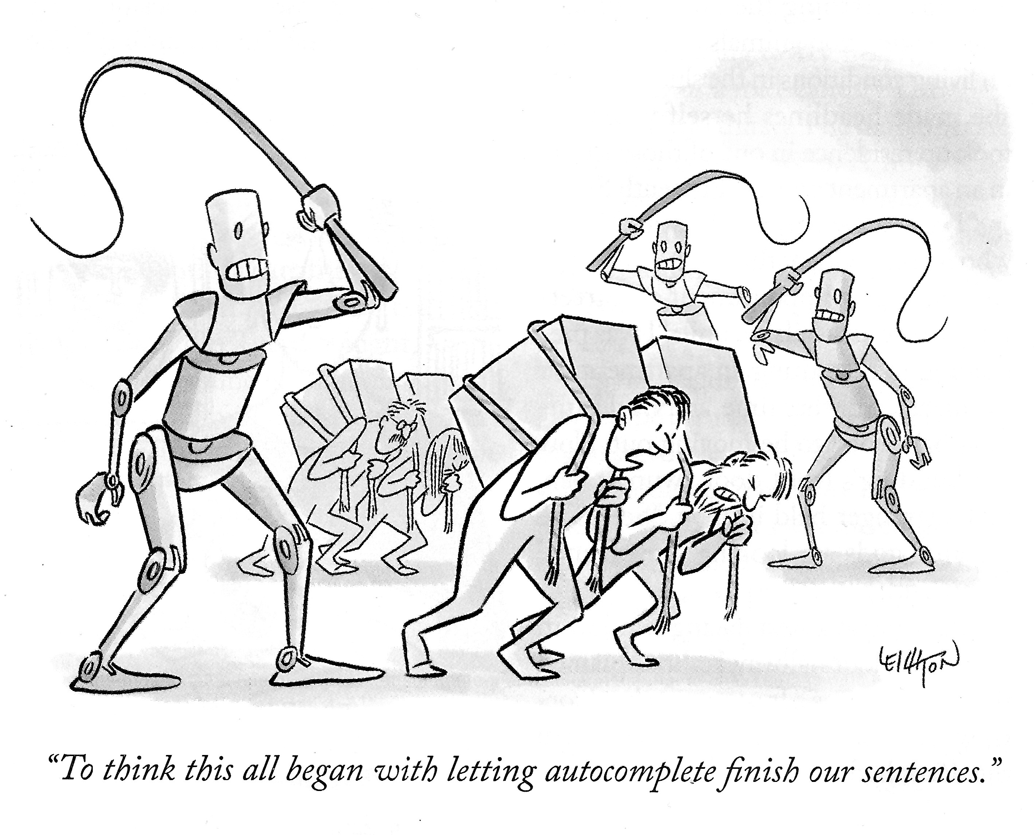
Notes:
But Every Sprint is a hassle.
Grooming meetings take 18 hours, Bob sleeps in the office during those.
The meeting is supposed to start with a popular check-in exercise like 2 truths and a lie, and in typical GPT fashion, as they can't tell between truth and lies, they start hallucinating and tell only lies.
This, in turn, makes the other AI GPTs confused, which makes the hallucinate even more.

Slide 19
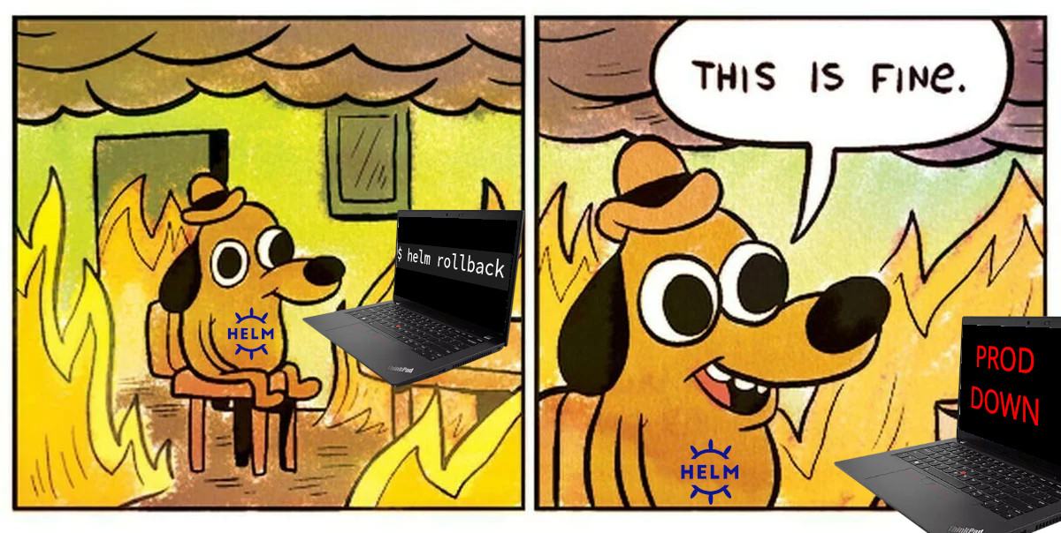
Notes:
But after a hard fought sprint, at the end they all hunker down, put their robot heads together and finish the sprint in the last hour.
And in typical developer fashion, their deployment breaks production

Slide 20
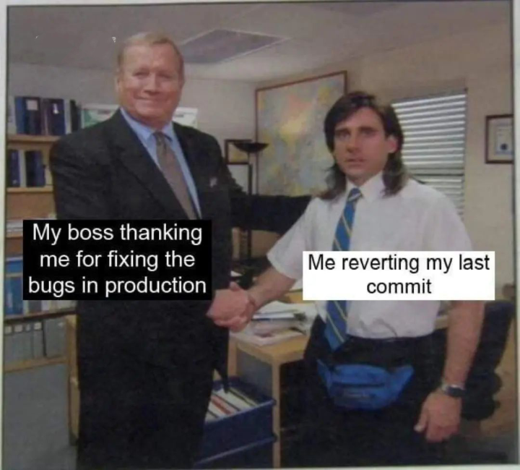
Notes:
And what does BOB do after production is down? Well, what 30 years of experience thought him to do. He just reverts the last sprint release and let the AI Engineering team start again from scratch! There has not been a new release in 5 years. And thats fine with Bob

Slide 21
Software Engineering in 2034
How not to build Software in the year
2035
@neciudan
Notes:
There you have it: How not to build Software in the year
2035
THank you

